Slide 1
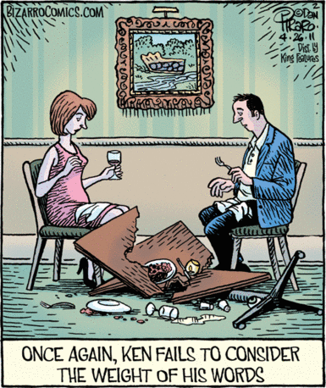
Figurative Language
Similes
Metaphors
Aliteration
Personification
Sensory Images (descriptions that appeal to taste, touch, sight, hearing, smell)

Slide 2
Two-Adjective Beginnings:
Tall, handsome lifeguards lounge in the towers.
Rickety and dilapidated, the old schoolhouse didn’t stand a chance in an earthquake.

Slide 3
“-ing” at beginning
Forrest Gump ran like the wind. He made national headline news.
Running like the wind, Forrest Gump made national headline news.
Saving the best for last, Lisa finally ate her Reese’s peanut butter cup.

Slide 4
“-ing” at end
He trudged along the hot desert for days. He wished he had brought more water.
He trudged along the hot desert for days, wishing he had brought more water.
Sandy gave the homeless man all the money she had, hoping that her small act of kindness might bring him some comfort.
Notes:
‹#›

Slide 5
“-ly” at beginning
The servant slowly opened the door. He tried not to wake his master.
Slowly opening the door, the servant tried not to wake his master.

Slide 6
Informative Interrupters – aka Appositives
The child asked his mother if he could have some milk.
The child, face covered with chocolate doughnut, asked his mother if he could have some milk.
Notes:
‹#›

Slide 7
Dependent Clauses & Phrases

Slide 8
Dependent Clauses & Phrases
Due to the torrential downpour.
Since the road construction is complete.
Notes:
‹#›

Slide 9
Dependent Clauses & Phrases
Due to the torrential downpour.
Phrase
Since the road construction is complete.
Clause

Slide 10
Clauses
A clause contains a subject and a predicate.
Notes:
‹#›

Slide 11
Clauses
A clause contains a subject and a predicate.
I am.

Slide 12
Clauses
A clause contains a subject and a predicate.
I / am.
subject predicate

Slide 13
Clauses – Dependent and Independent
He shoots he scores.
He shoots, he scores.
Notes:
‹#›

Slide 14
Clauses – Dependent and Independent
He shoots he scores. Run on
He shoots, he scores. Comma Splice

Slide 15
Clauses – Dependent and Independent
He shoots he scores. Run on
He shoots, he scores. Comma Splice
He shoots, and he scores.
When he shoots, he scores.

Slide 16
Clauses – Dependent and Independent
He shoots he scores. Run on
He shoots, he scores. Comma Splice
He shoots, and he scores.
When he shoots, he scores.
He shoots. He scores.
He shoots; he scores.

Slide 17
Dependent Clauses & Phrases
Due to the torrential downpour, the garden party was postponed.
Since the road construction is complete, Jim can drive home in only ten minutes.
Notes:
‹#›

Slide 18
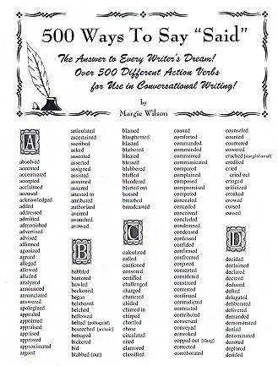
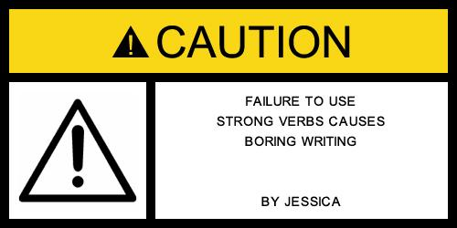
Action Verbs
Plenty here and http://www.cvisual.com/film-techniques/writer-action-verb-list.pdf

Slide 19
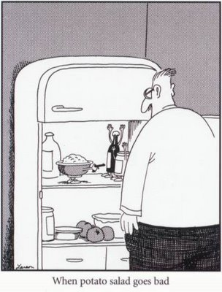
Hyphenated Modifiers
Descriptive words, linked by a hyphen, that invite readers to “take notice.”
A hyphenated modifier is a compound adjective or adverb created by hyphenating multiple words together that work as one word.
Example: He gave me that there's-a-dead-body-in-my-fridge sort of smile.

Slide 20
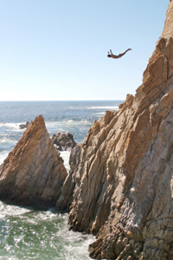
Variety in Structures…
Sometimes, wacky, creative exceptions to “traditional” sentence structures work, because they create effective writing. Two of these are the:
Sentence fragment, for effect.
Single word sentences,
for effect.
But…just because you “can,” does that mean you should?

Slide 21
The operative phrase is “for effect”! Breaking form works only some of the time, which means
infrequently and only, only, only if what you are writing truly “needs” a snap.
Ask yourself:
Is this choice intentional in creating an impression on my reader?
If not, readers will doubt your credibility; they’ll feel something is wrong that needs to be fixed. Remember: intentional, effective impression!

Slide 22
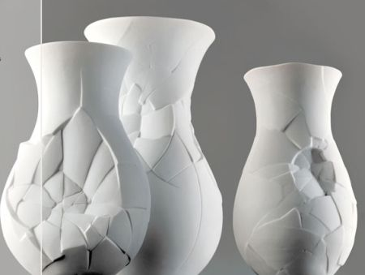
Sentence fragments. For effect!!
Imprisoned forever.
A broken heart.
Not true.
Get serious.

Slide 23
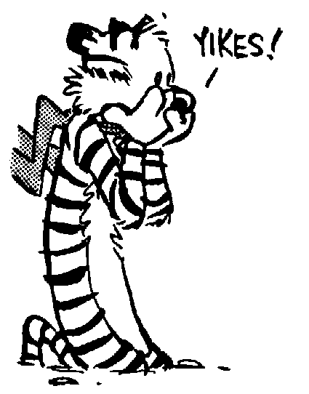
Single word “sentences”
An example from Matt’s story, when he realizes his girlfriend didn’t like him much…
I talked with my friends, Logan and Caleb, about my most terrible secret: I still wasn’t over my break up with Mary. They both suggested I talk to her, so I did. Worst. Idea. Ever. Every terrible emotion came crashing down on me the moment I heard her voice on the other line…

Slide 24
Narrative and Descriptive Essays
Read through each of the note packages. Be able to tell me the differences between narrative and descriptive composition.
Read the following essays:
“My Mother’s Blue Bowl”
“A Secret Lost in the Water”
Identify:
as either narrative and descriptive
Examples of writer’s craft – be prepared to share your examples
Which piece do you prefer? Explain why?
Be prepared to make criticisms as well

